Slide 1
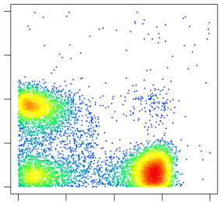
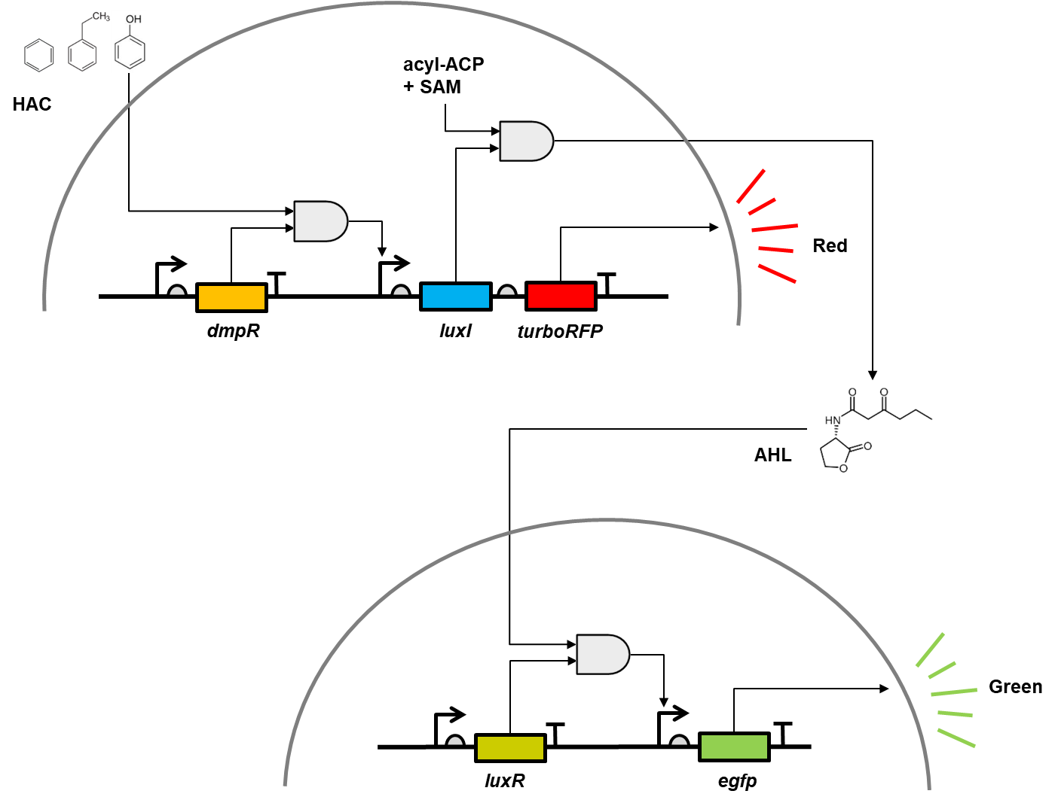
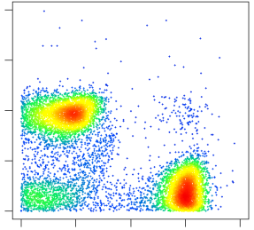
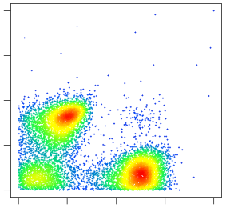
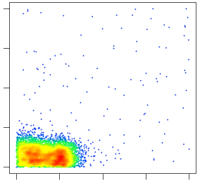
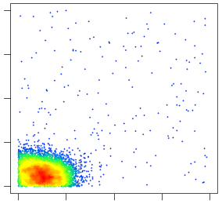
(B)
Phenol 1000μM
(A)
RFP
0 10 10² 10³ 10⁴
Phenol 100μM
RFP
0 10 10² 10³ 10⁴
Phenol 10μM
RFP
0 10 10² 10³ 10⁴
Phenol 1μM
RFP
0 10 10² 10³ 10⁴
Figure 1. Mixed microbial biosensor construction. (A) schematic diagram of the mixed microbial biosensor. Hazardous aromatic compounds (HAC) activate DmpR which expresses LuxI and turboRFP in a detector cell. LuxI converts S-adenosylmethionine (SAM) and an acylated acyl carrier protein (ACP) to acyl homoserine lactone (AHL) which triggers egfp expression in reporter cells. (B) Single cell level florescence distribution of the mixed microbial biosensor. Phenol molecules triggers detector cells to express red fluorescence protein (RFP) while reporter cells to produce green fluorescence protein (GFP).
Phenol 0μM
RFP
0 10 10² 10³ 10⁴
0 10 10² 10³ 10⁴
GFP

Slide 2
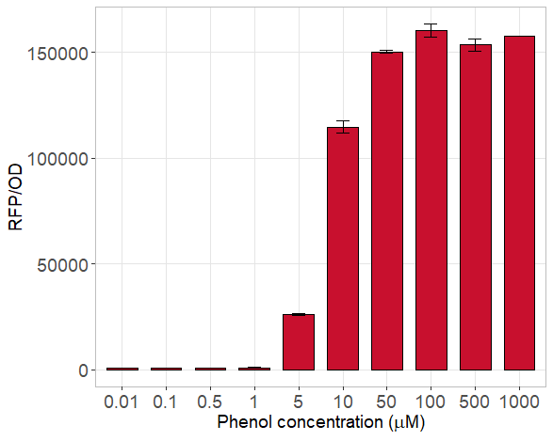
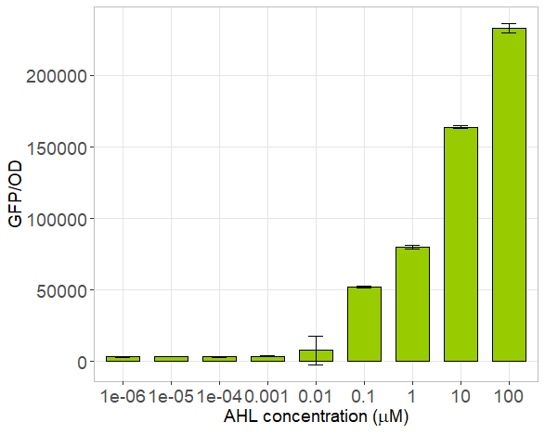
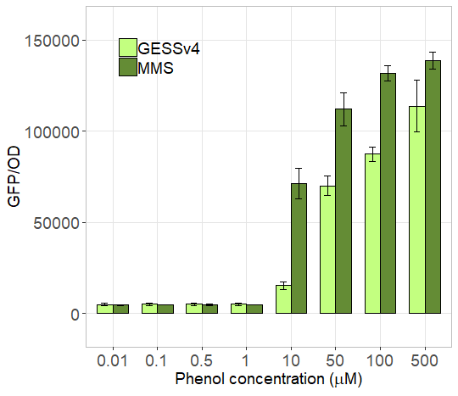
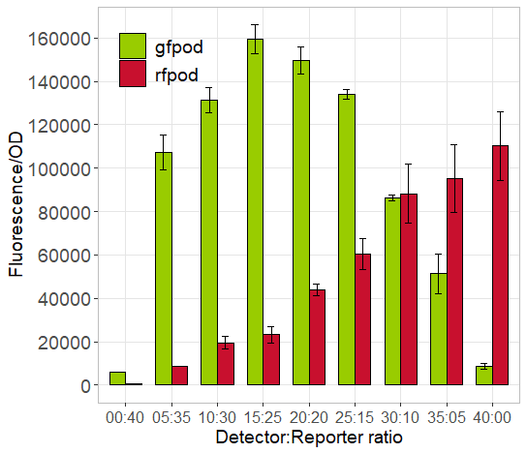
(A)
(B)
(C)
(D)
Figure 2.

Slide 3
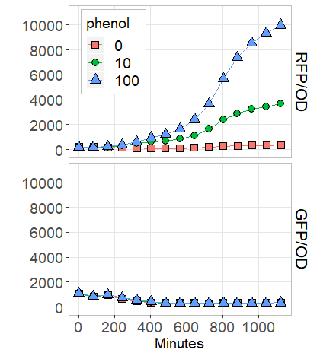
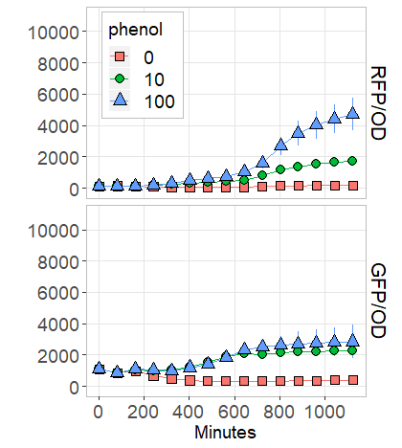
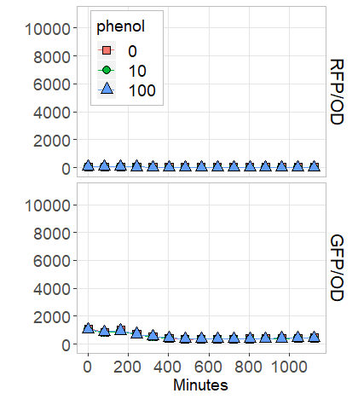
(A)
Detector only
(B)
Mixed 1:1
(C)
Reporter only
Figure 3.
Notes:
성장에 따른 손실 최소화
시간 경과 전 형광 올라옴
RFP에 의한 형광 손실

Slide 4
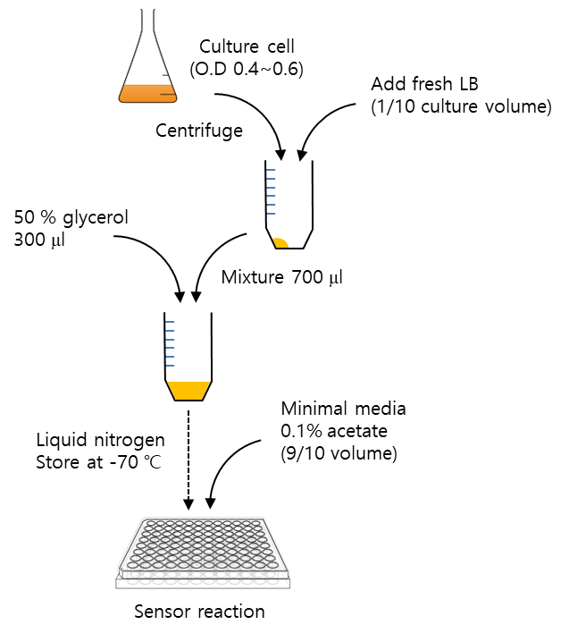
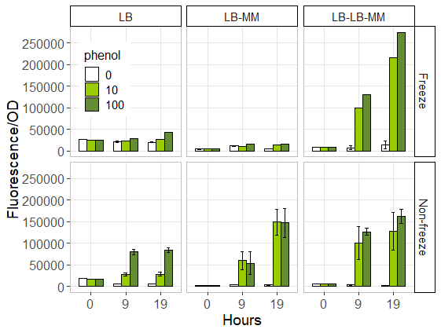
(A)
(B)
Figure 4.

Slide 5
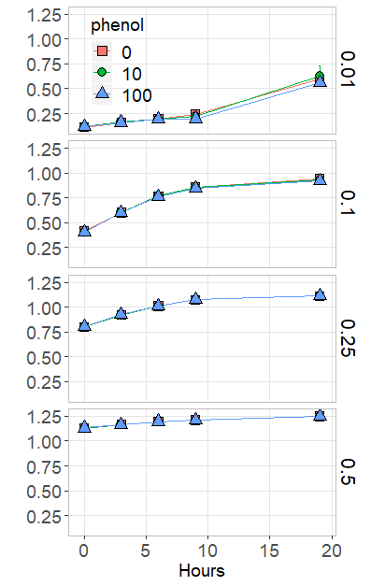
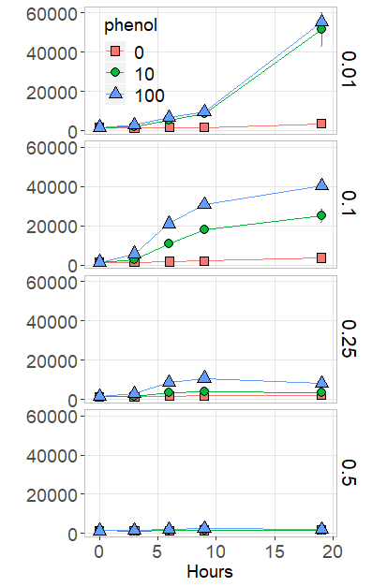
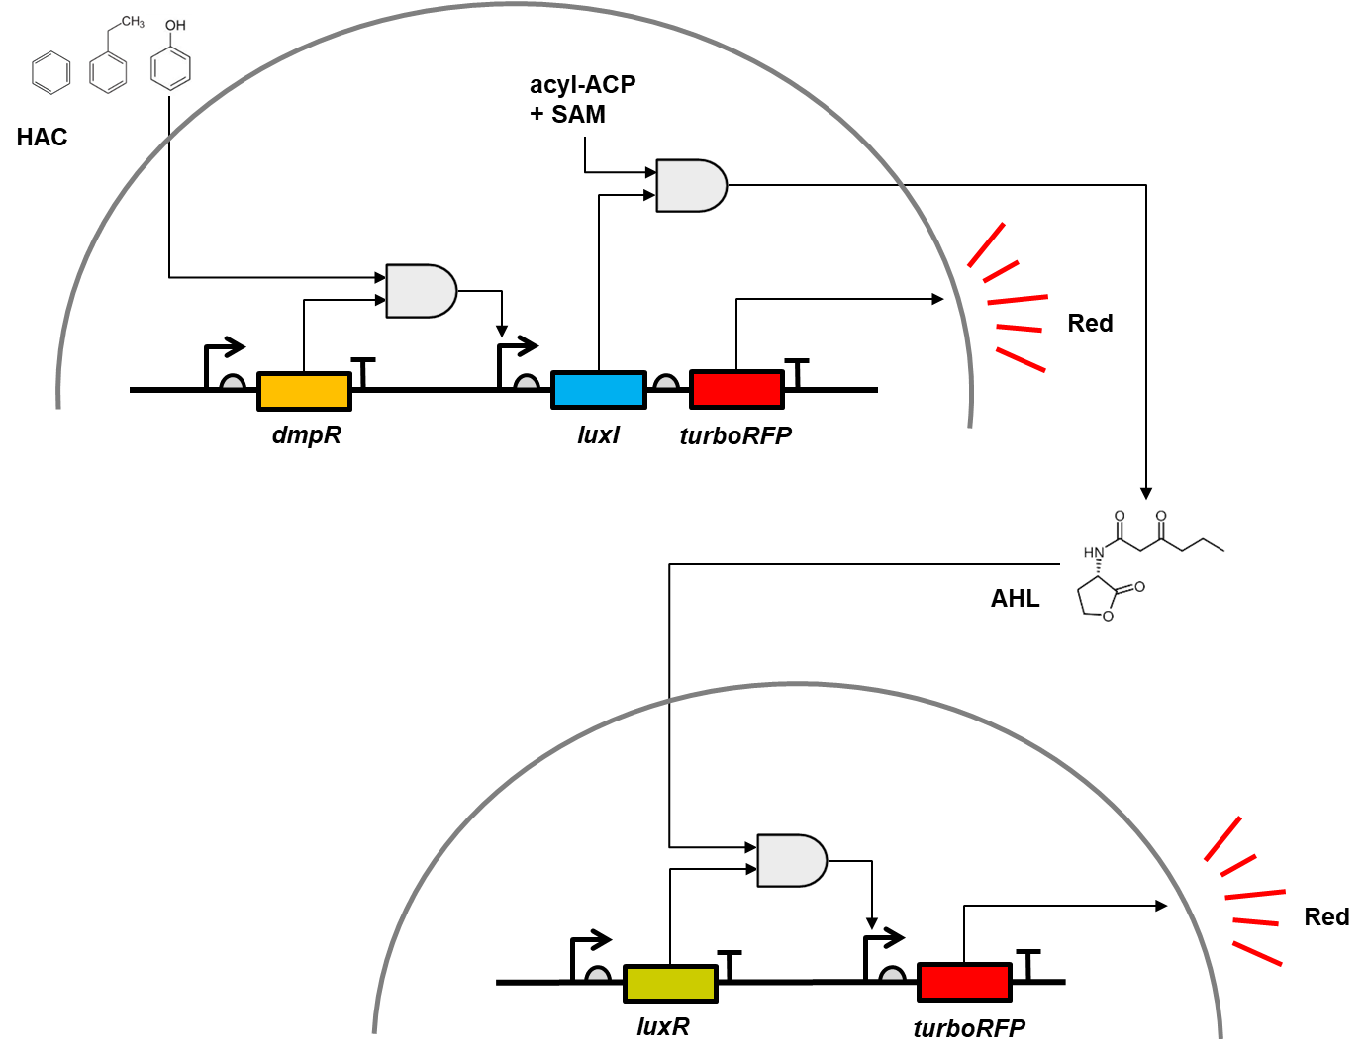
(A)
OD
(B)
GFP
(C)
Figure 5.

Slide 6
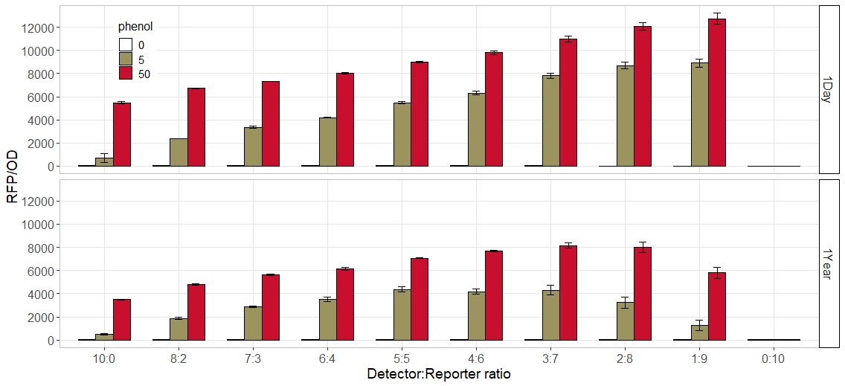
Figure 6.

Slide 7
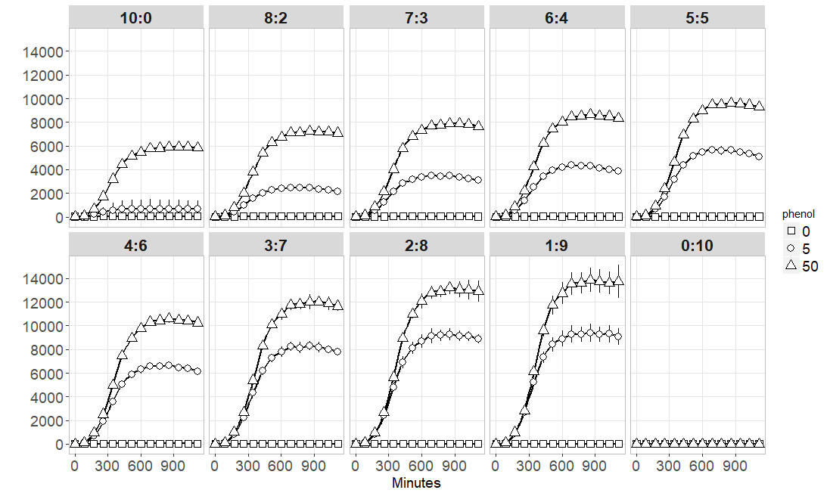
Sender receiver ratio of FMMS
RFP/OD

Slide 8
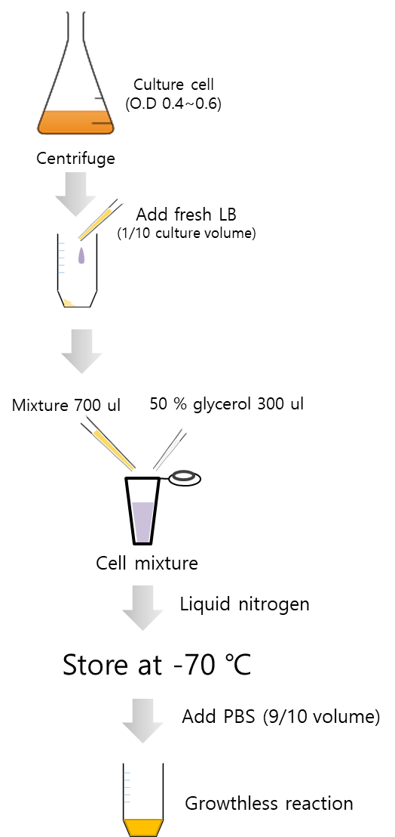
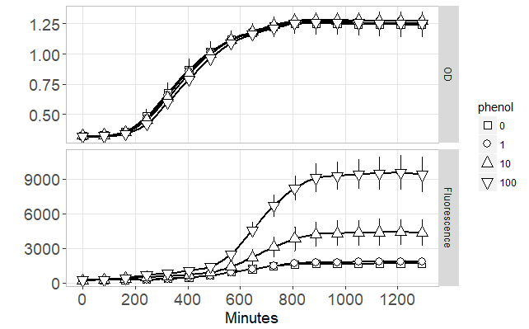
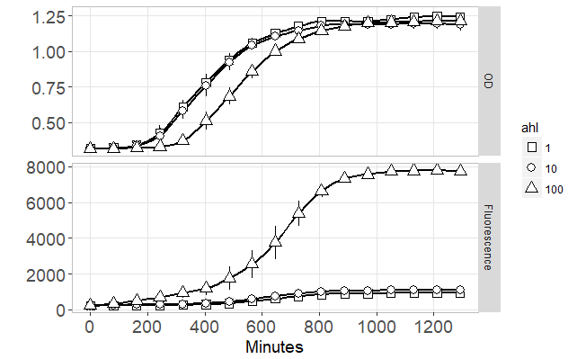
Freeze based mixed microbial biosensor
(A)
(B)
(C) Mixing ratio

Slide 10
Remote detection of hazardous chemicals with cell-cell communication genetic circuits
유해물 감지 필요성으로 인한 다양한 바이오센서 개발되고 있음
그러나 유해물 특성상 원거리 감지 필요하며 따라서 바이오센서의 경우 높은 가시화 효율 및 그에 상응하는 측정 디바이스 필요 (ex 폭발물)
세포간 통신 유전자 회로 구축을 통한 감지 신호 증폭 및 범위 확장
3D 프린터 및 아두이노 응용한 저가형 형광 감지 및 분석 디바이스 개발
Alginate Bead 기반의 유해물 (페놀) 감지를 통한 실용화 모델 제시
In this paper,
Notes:
Vibrio fischeri

Slide 12
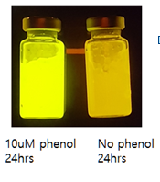
Figure 3

Slide 13
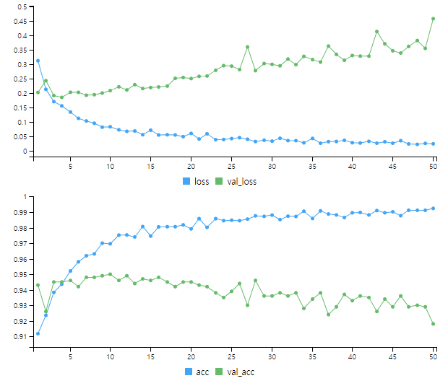
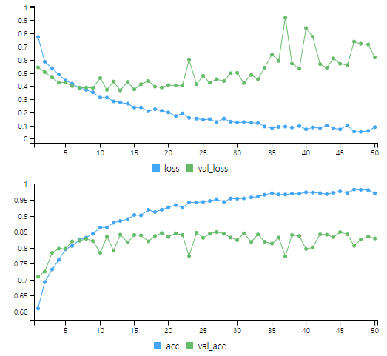
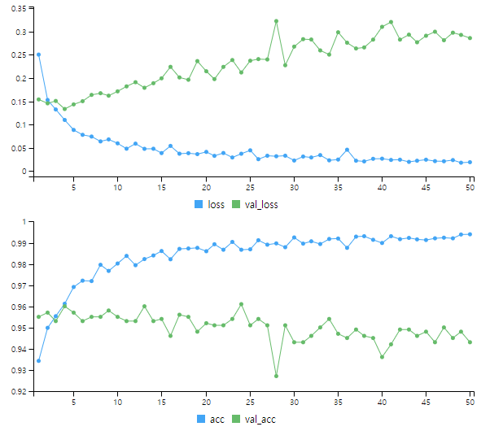
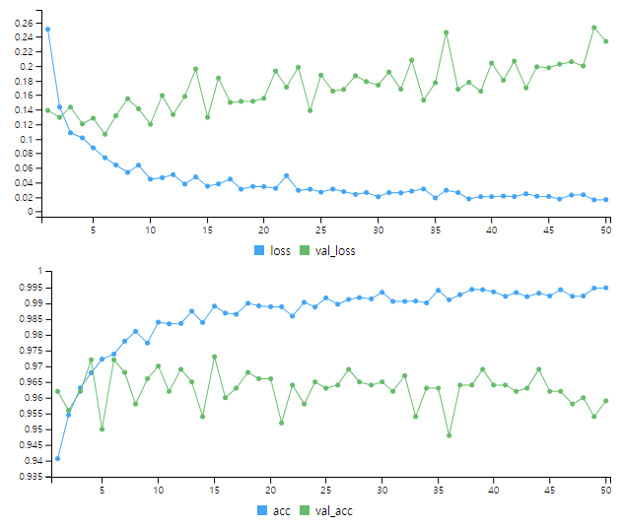

Slide 14
PNP
A DNAStringSet instance of length 5
width seq names
[1] 1281 ATGACGTCGGCGCGCACCATCGCCTTCATCGTCGTCACCATCT...GATGCCGGCGAGCGATCAGATGCCGCCGTCGGTCACCGCATAG 1_1729879_ORF2_pn...
[2] 1455 ATGGCCTCGCGGCGTGTCCAAGGAGGAGGCGCACATCGACGAC...CGAGGCGTTCGATCGGCTACGCGACCTGATCGCCGCACCCTAG 1_3915603_ORF6_pn...
[3] 951 ATGGTACAGGGTCCGGATCGACGAGGTGGGAAAGAAGTCCGCG...CTCGGGAGGGATCAGAGTGCGCTTATGCGCTGTCGGGCGGTAA 1_6685848_ORF1_pn...
[4] 1053 ATGGGCCGGCAACGACAGCAACGAGATGACCGATCCGAACGGT...GCCTGAGGGCTGCCGACGTCGAGACGCGGCAACGAAAGAGTAG 1_75455982_ORF17_...
[5] 2013 ATGCCTAAAGTAACCGTAGATGGCGTAGAAATCGACGTTCCGC...AGAGCTGGTCCATGGCGCGGATTTTGCGGAGGCGGCGGAATGA 1_75535950_ORF5_p...
pnp
[1,] 0.12076
[2,] 0.97812
[3,] 0.00499
[4,] 0.99999
[5,] 0.00000
phenol
[1,] 0.32245
[2,] 0.60745
[3,] 0.00001
[4,] 0.00538
[5,] 0.01049
[6,] 1.00000

Slide 15
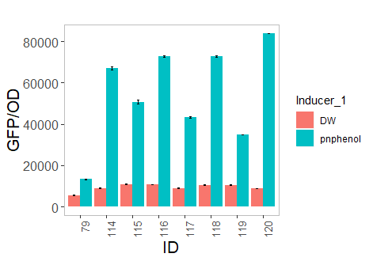
pNP – ALL (F5/C5/T10)
no | orf_names | index
1 | 1_1729879_ORF2_pnphenol_1_NODE_2273 | 114
2 | 1_3915603_ORF6_pnphenol_1_NODE_550 | 115
3 | 1_6685848_ORF1_pnphenol_1_NODE_1160 | 120
4 | 1_75455982_ORF17_pnphenol_1_NODE_658 | 118;119
5 | 1_75535950_ORF5_pnphenol_1_NODE_622 | 116;117
6 | pnphenol_NC | 79
No | strain_name | length | cover | identity
1 | uncultured Sphingopyxis sp. | 1281 | 99.22 | 90.37
2 | Kibdelosporangium phytohabitans | 1455 | 62.06 | 73.42
3 | Cupriavidus necator H16 | 951 | 99.89 | 100
4 | Actinoalloteichus sp. AHMU CJ021 | 1053 | 74.07 | 76.28
5 | Sphingopyxis sp. EG6 | 2013 | 100.4 | 90.75
No | protein | length | cover | identity
1 | tetracycline resistance MFS efflux pump [Sphingopyxis alaskensis] | 427 | 100 | 85
2 | aminotransferase class I/II-fold pyridoxal phosphate-dependent enzyme [Blastococcus sp. Marseille-P5729] | 485 | 80 | 77
3 | putative iron transport protein (plasmid) [Cupriavidus necator H16] | 317 | 93 | 100
4 | amidohydrolase [Antricoccus suffuscus] | 351 | 93 | 78
5 | MULTISPECIES: NADH-quinone oxidoreductase subunit G [Sphingopyxis] | 671 | 100 | 99

Slide 16
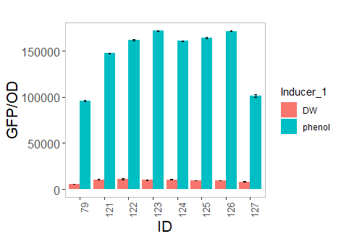
Phenol – ALL (F6/C6/T10)
no | orf_names | index
1 | 1_59802832_ORF1_phenol_1_NODE_1800 | 125
2 | 2_123078163_ORF1_phenol_2_NODE_5457 | 123
3 | 2_2499531_ORF2_phenol_2_NODE_6716 | 121;122
4 | 2_403399441_ORF6_pnphenol_1_NODE_415 | 126
5 | 2_462037_ORF1_phenol_2_NODE_3294 | 124
6 | 2_667467156_ORF1_phenol_2_NODE_6501 | 127
7 | phenol_NC | 79
No | strain_name | length | cover | identity
1 | Sphingopyxis sp. EG6 | 1584 | 82.64 | 91.37
2 | uncultured Sphingopyxis sp. | 927 | 100.22 | 93.54
3 | Rhodospirillum centenum SW | 1758 | 9.33 | 76.22
4 | Cupriavidus pauculus | 1323 | 99.92 | 97.81
5 | Oligotropha carboxidovorans OM5 | 948 | 97.89 | 75.11
6 | uncultured Sphingopyxis sp. | 1662 | 94.1 | 83.5
No | protein | length | cover | identity
1 | dihydrolipoyl dehydrogenase [Sphingopyxis sp. LC363] | 528 | 80 | 97
2 | thiamin (pyrimidine moiety) biosynthesis protein [uncultured Sphingopyxis sp.] | 309 | 98 | 99
3 | SLC13 family permease [Alphaproteobacteria bacterium HGW-Alphaproteobacteria-13] | 586 | 100 | 83
4 | NAD-dependent succinate-semialdehyde dehydrogenase [Cupriavidus basilensis] | 441 | 100 | 98
5 | LPS biosynthesis protein [Afipia sp. 1NLS2] | 316 | 97 | 98
6 | ribonuclease J [Sphingopyxis sp. WS5A3p] | 554 | 72 | 95

Slide 17
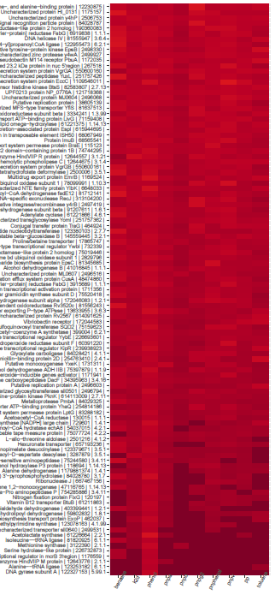
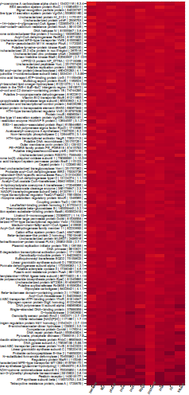
Phenol - ALL
pNP- ALL

